Slide 1
Forecasting U.S. Airline Industry Trends with Time Series Models
Group 3 Group Name: TrendTakeoff Group Members: Andi Zhang, Serena Liu, Victoria Fu, Charlotte Liao

Slide 2

Goal Statement
This project aims to analyze historical U.S. airline traffic data to identify key patterns and trends. Using advanced time series forecasting models, we will predict airline passenger traffic, flight volume, and revenue passenger-miles for the next 12 months. By incorporating macroeconomic indicators such as GDP and jet fuel prices, we seek to provide insights that help airlines optimize flight scheduling, adjust capacity, and respond efficiently to market demand

Slide 3

Key Research Questions
Main Question:
How have U.S. airline passenger traffic, flight volume, and revenue passenger-miles evolved over time, and how accurately can time series forecasting models predict these values for the next 12 months?
Sub-questions:
What seasonal and cyclical patterns exist in domestic and international airline travel?
How do long-term trends in U.S. airline travel differ between the pre-COVID and post-COVID periods?
How well do different time series forecasting models perform in predicting airline passenger traffic, flight volume, and revenue passenger-miles?

Slide 4
Datasets Overview
Air Traffic
Time Span: 2003-01 To 2023-09
Number of Variables: 17
Jet Fuel Price
Used Price (transformed)
External Factors
US Monthly GDP
Used Real_GDP
PAX (Passengers)
FLT (Flights)
RPM (Revenue Passenger Miles)
LF (Load Factor)
Total Air Travel Passengers
Number of Total Flights
Number of passengers and the distance flown in thousands
passenger-miles as a proportion of available seat-miles in percent
Related to Seat Demand
Related to Profitability

Slide 5
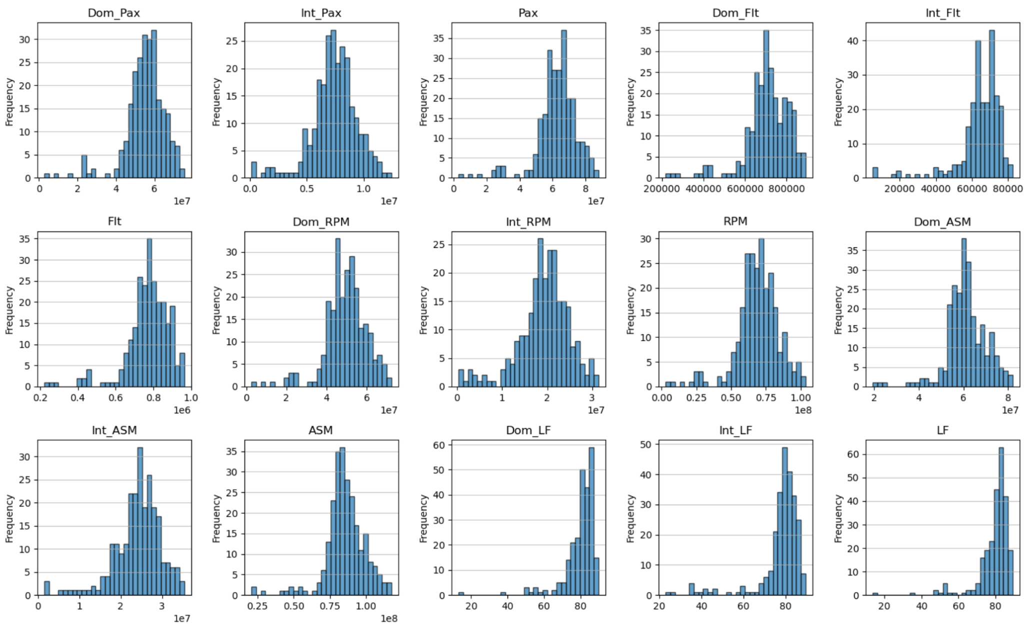
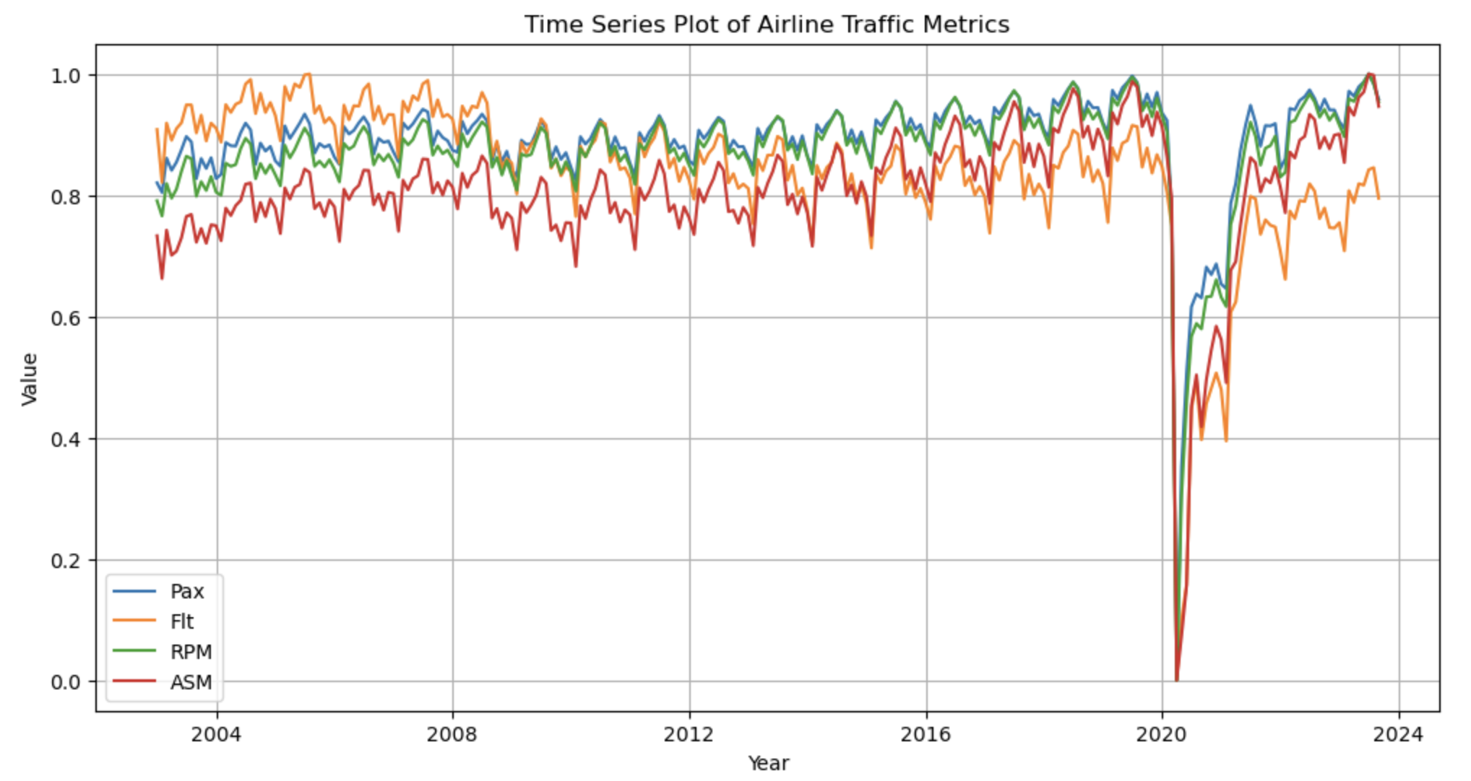
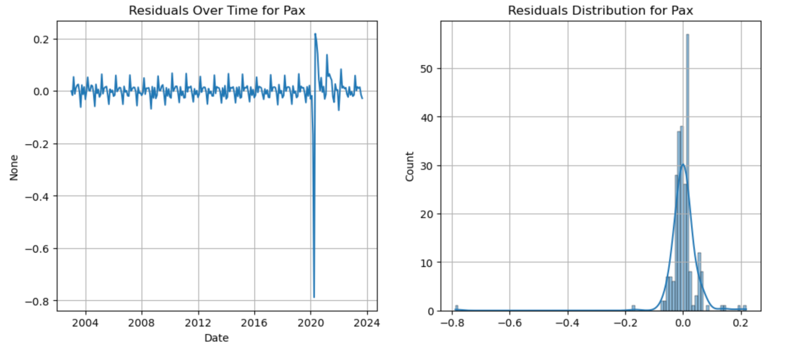
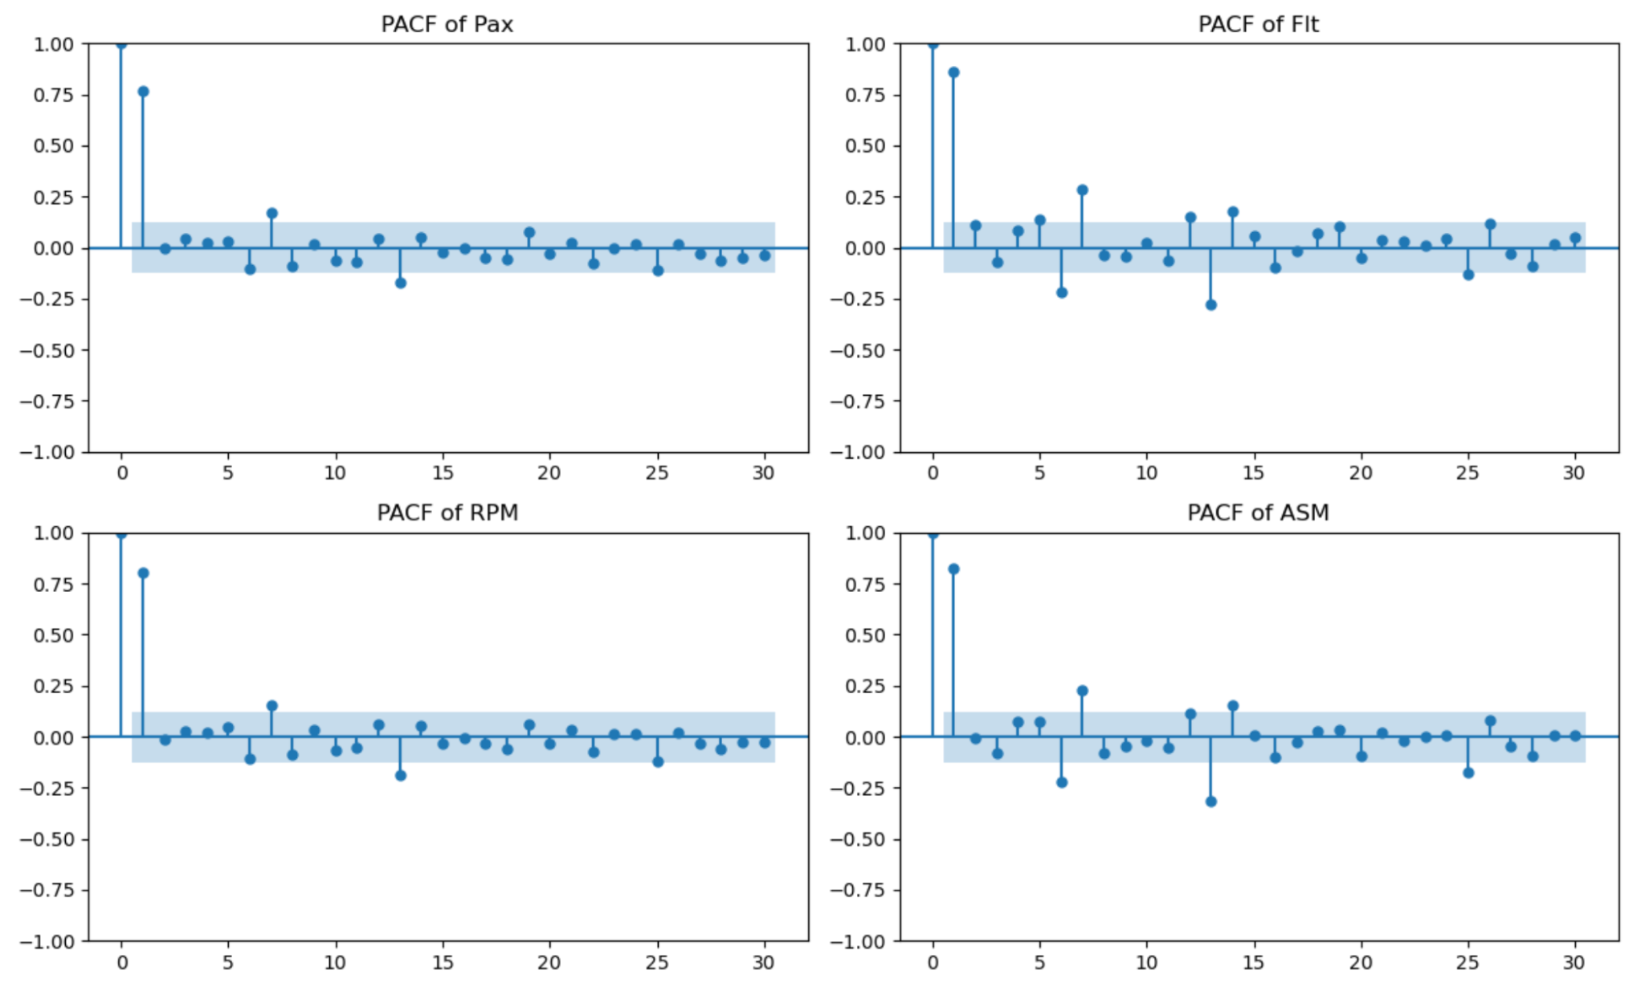
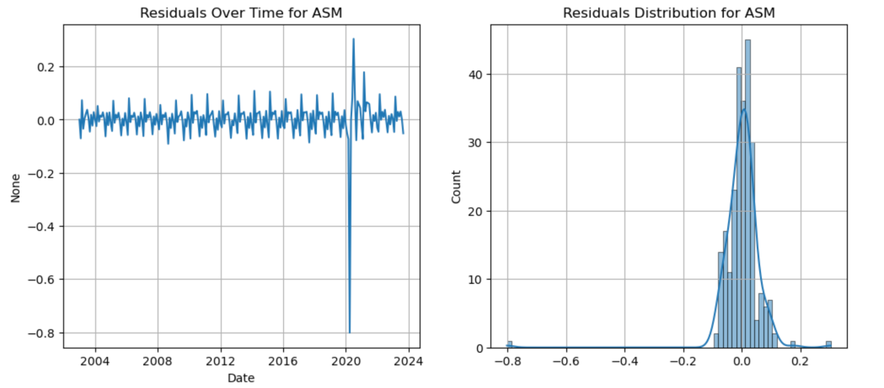
EDA Air Traffic Data
Most variables exhibit skewed distributions, suggesting need for log transformation. Data was also then normalized for ML models.
Distribution of residuals appears approximately normal but with slight skewness, residual time series plot suggests heteroscedasticity
Strong lag-1 correlation suggests a strong autoregressive structure. Additional lags indicate that AR(p) models with multiple lags may be necessary.
Notes:
The PACF plots indicate that the airline traffic metrics have a strong immediate lag-1 correlation, suggesting that past values significantly influence current values. However, higher-order lags quickly diminish, indicating a short-term dependency structure. The seasonal decomposition plots reveal clear long-term trends and strong seasonality across all metrics, with a substantial drop around 2020 due to the pandemic, followed by a gradual recovery. The residual plots show mostly stable patterns.

Slide 6
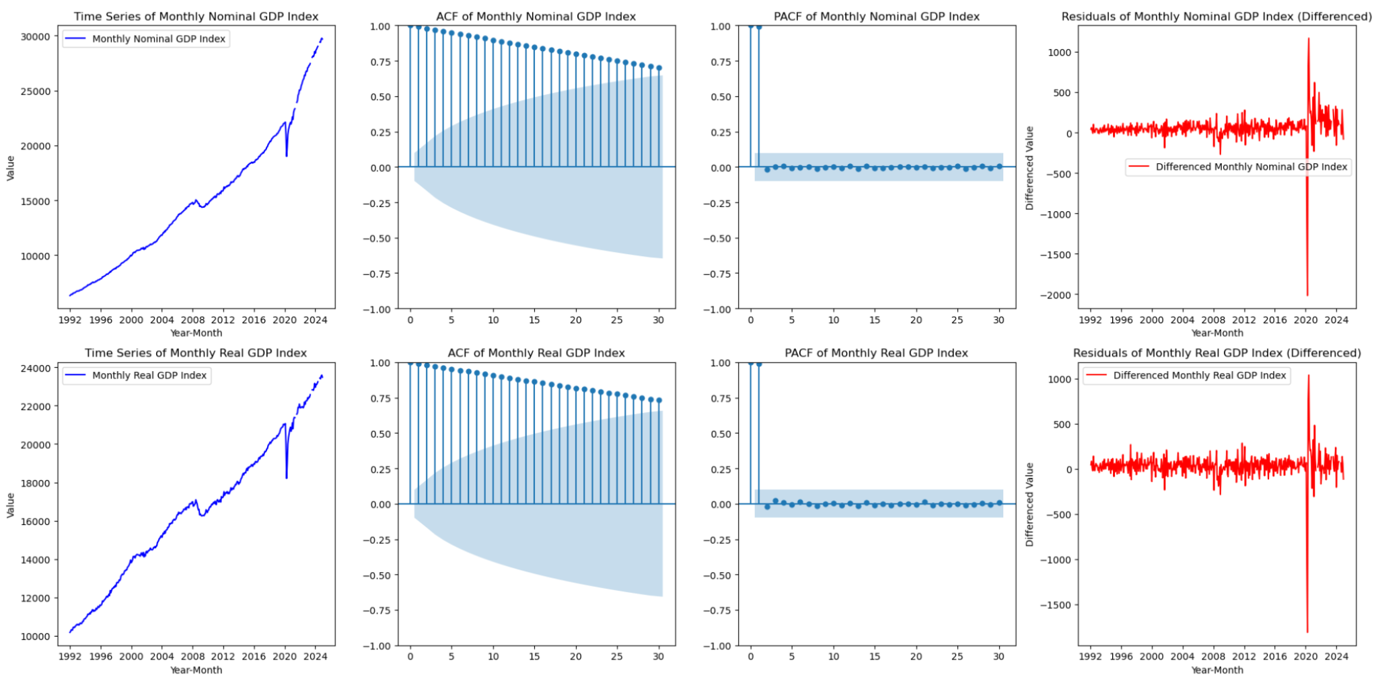
EDA Monthly GDP
Strong upward trend
ACF slows gradual decay → confirms long-term trend and autocorrelation
PACF drop after lag 2 → suggesting need for differencing
After differencing, the residuals show stability, indicating that differencing has helped in making the series stationary. However, residual plot reveal spike around 2020 → Data around 2020 should be treated differently for better long-term trend forecasting.
Notes:
The time series plots of Monthly Nominal GDP Index and Monthly Real GDP Index show strong upward trends, indicating non-stationarity. The ACF plots display slow decay, confirming persistent autocorrelation, while the PACF plots show a sharp drop after lag 1, suggesting a need for first-order differencing. The residual plots after differencing exhibit more stability but reveal large spikes around 2020. Data around 2020 will be removed for long-term trend forecasting.

Slide 7
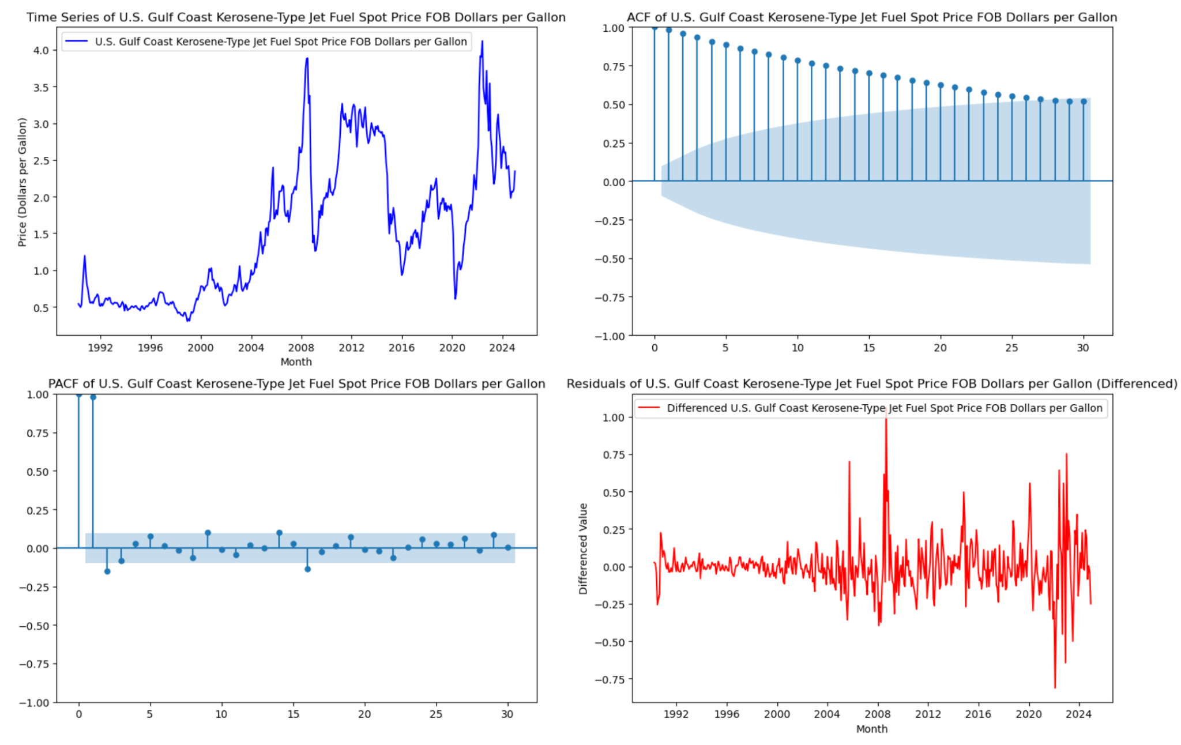
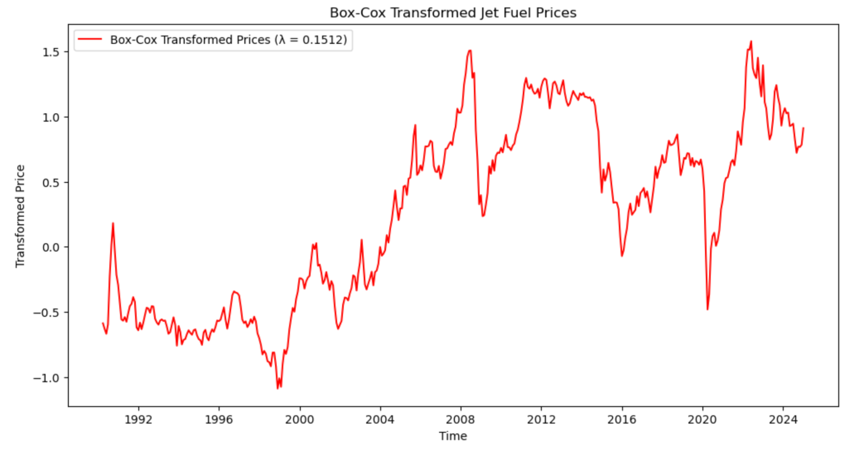
EDA Jet Fuel Price
Upward trends and sharp fluctuations
Residual plot after differencing shows reduced trend effects but retains volatility
Box-Cox transformed jet fuel price series shows a more stabilized variance, but it still exhibits fluctuations, particularly during economic crises and geopolitical shocks
Notes:
The time series plot of jet fuel prices shows strong volatility with clear upward trends and sharp fluctuations, particularly around 2008 and 2022, which is related to economic or geopolitical shocks. The ACF plot indicates a slow decay, confirming strong autocorrelation and trend persistence. The PACF plot has a significant lag-1 spike, suggesting that a first-order differencing (d=1) may help in making the series stationary. The residual plot after differencing shows reduced trend effects but retains volatility, I'll use box-cox transformation to stabilize volatility.
The Box-Cox transformed jet fuel price series shows a more stabilized variance compared to the original series, but it still exhibits noticeable fluctuations, particularly during economic crises and oil price shocks. While the transformation reduces heteroscedasticity, there are still periods of high volatility, especially around 2008, 2014, and 2020. This suggests that additional modeling techniques, such as differencing or GARCH models, might be necessary to further address volatility in the series.

Slide 8
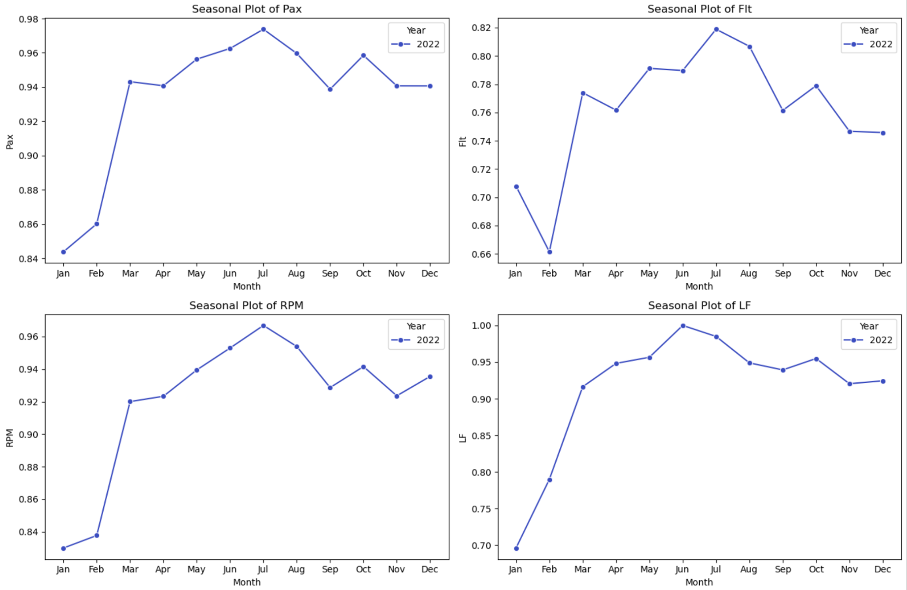
Data Preprocessing
1. Convert time columns to date format and set index for analysis
2. Check for missing data among all datasets → No missing values
4. Applied first-order differencing for SARIMA
3. Log-transform skewed variables and Min-Max normalize the dataset
5. Box-Cox transformed highly fluctuating jet fuel prices
6. Removed Data from 2020 and 2021 from training and testing data for long term forecasting
Strong seasonality is evident, with all variables peaking in the summer months (June–July) and dropping in winter (January–February). March sees a sharp rise, likely due to spring break, November–December stabilizes, likely because of early purchasing before the holiday season.

Slide 9
Analysis Plan
Model | Why | Y | X (Include external variables?) | Training Data | Testing Data | Evaluation Metrics*
SARIMA/ SARIMAX* | Captures seasonality & trend, best for stable patterns, widely used in airline forecasting. | Pax, Flt, LF, RPM | No/ Yes | Pre-COVID only (2003-2019) (Avoids structural break from COVID) | 2023-04 to 2023-09 | AICc, RMSE, MAE
BSTS | Handles time series uncertainty, captures economic impacts, Bayesian approach helps detect shocks. |  | Yes, monthly real GDP and transformed fuel price | Full dataset (2003-2023, including COVID) (Uses Bayesian modeling to adjust for COVID impact)
Prophet | Best for seasonality & trend shifts, robust to missing data, automatic changepoints for disruptions. |  |  | Full dataset (2003-2023, including COVID with changepoints) |  | RMSE, MAE
XGBoost | Handles non-linear effects, feature selection helps find key demand drivers, good for large datasets. |  |  | Pre-COVID only (2003-2019) (Trained on stable data to avoid overfitting)
Based on evaluation metrics comparison, we will choose the best model to denormalize for business interpretations and one-year forecast.
*See SARIMAX in Appendix.
**See reasons of choosing these metrics in Appendix.

Slide 10
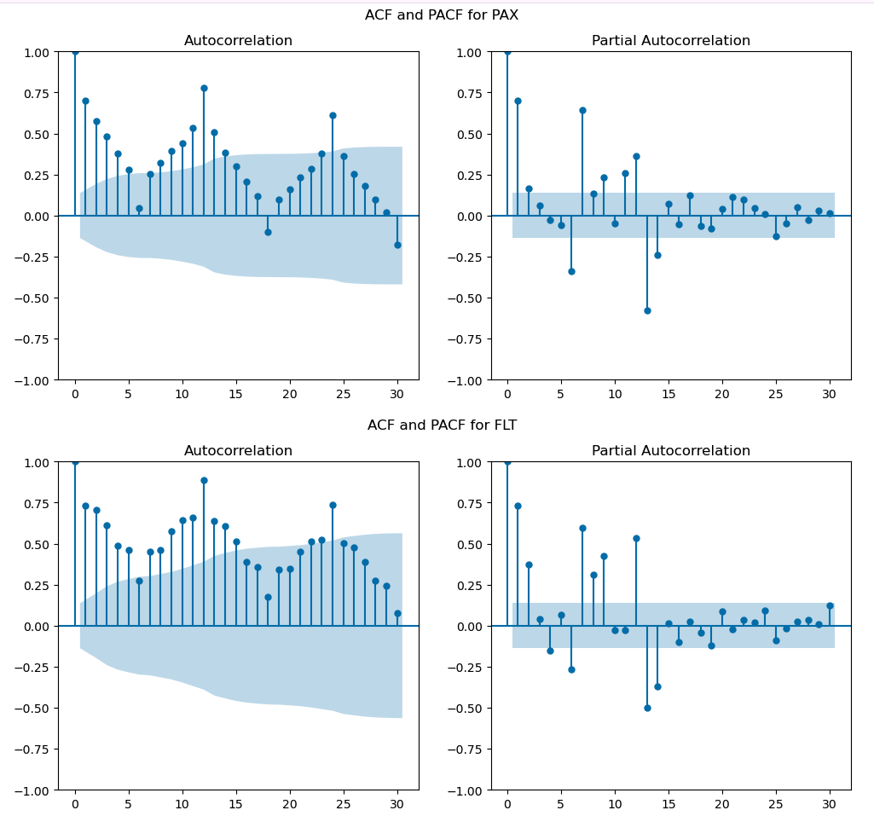
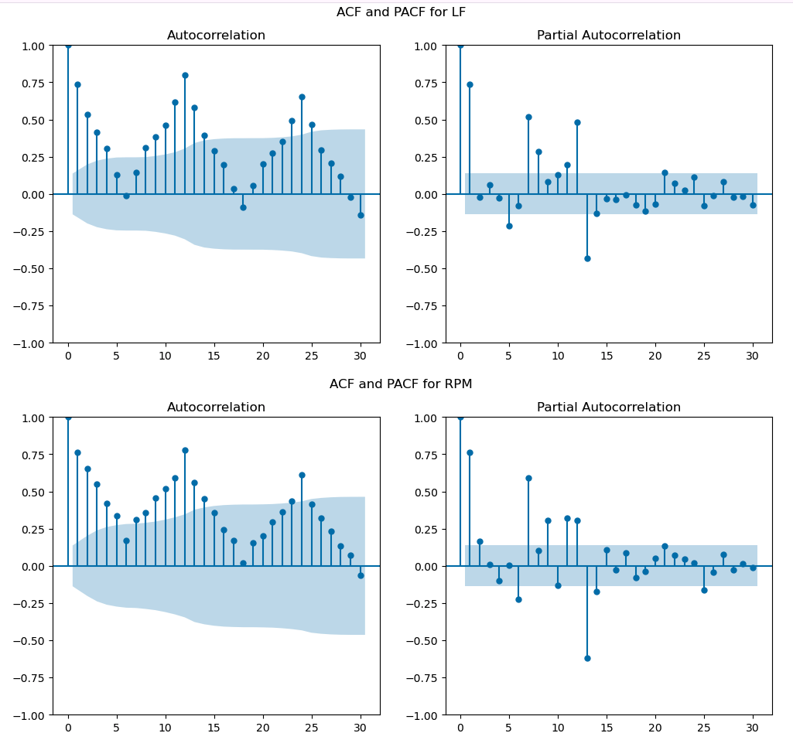
SARIMA：Non-stationarity and Seasonality
ACF: All four variables show strong positive autocorrelations at multiple lags, gradually declining over time. This suggests non-stationarity, meaning differencing may be required to stabilize the series. The ACF also exhibits peaks at seasonal lags (around 12 months), indicating seasonality.
PACF: PACF shows sharp spikes at lag 1 and a few later lags (e.g., 2 and 12), indicating a strong autoregressive (AR) component. Since PACF cuts off after a few lags rather than decaying gradually, an AR(p) process is likely needed.
Augmented Dickey-Fuller (ADF) test*: All p-values are significantly greater than 0.05, verifying that all variables are non-stationary.
Likely need SARIMA(p,d=1,q)(P,D=1,Q,s=12) → Used Auto-ARIMA for optimal parameter tuning
*See ADF results in Appendix.

Slide 11
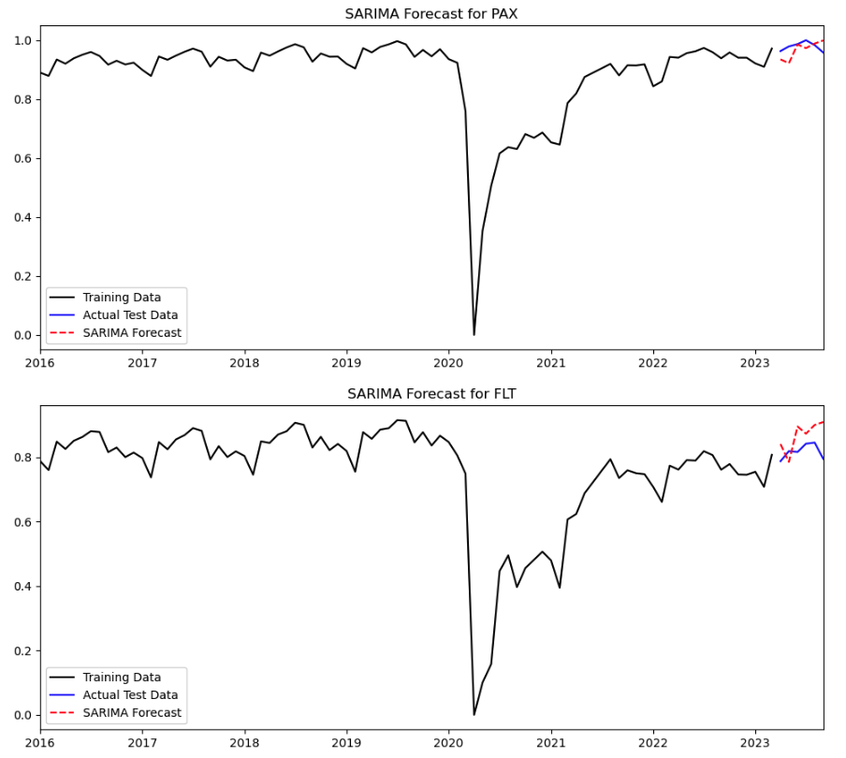
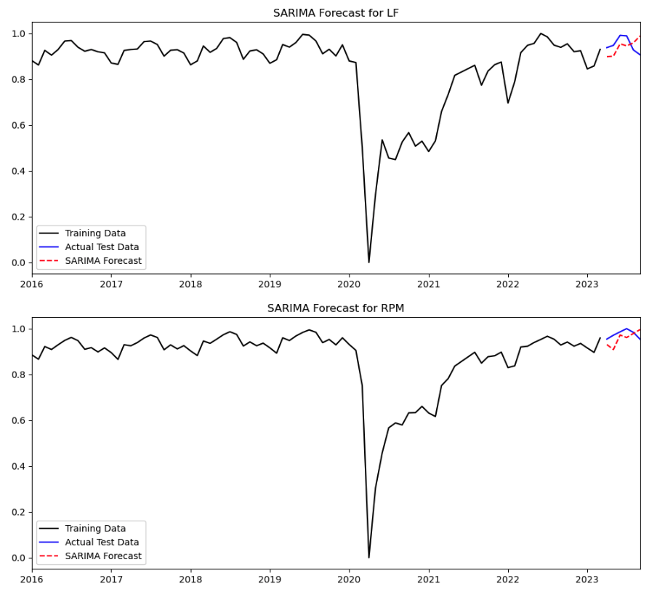
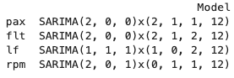
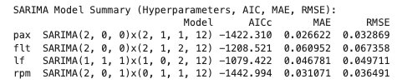
SARIMA：Performance of Optimal Models
Optimal Models:
❓Why d/D = 0 in some models?
Trend Removal via AR Terms Instead of Differencing
Even though the ADF test suggests non-stationarity, Auto-ARIMA may find that an autoregressive (AR) component (p>0) captures the trend effectively, making differencing unnecessary (d=0).
Seasonal Differencing is Preferred Over Regular Differencing
In most cases, Auto-ARIMA selected D=1, meaning it applied seasonal differencing at a 12-month lag. If seasonal differencing (D=1) sufficiently stabilizes the series, regular differencing (d=1) may not be necessary.
Key Findings:
SARIMA captures overall trends well but predicts seasonal variations slightly earlier in the seasonal cycle than actual data.
One potential cause is that the model relies on past seasonal patterns, not fully adapting to recent shifts in travel behavior, especially after the shock of Covid.
Also, SARIMA relies on rigid seasonal assumptions and cannot account for external market factors.
*We also tried SARIMAX to include external factors. See details in Appendix.

Slide 12
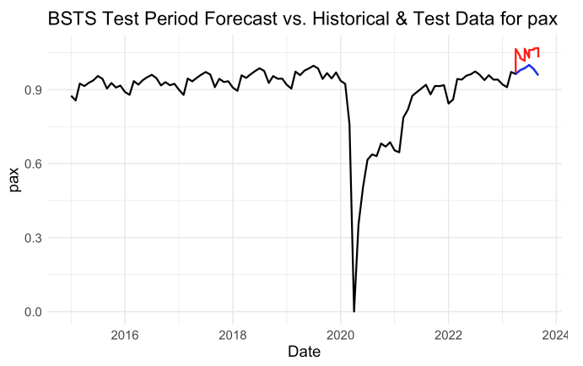
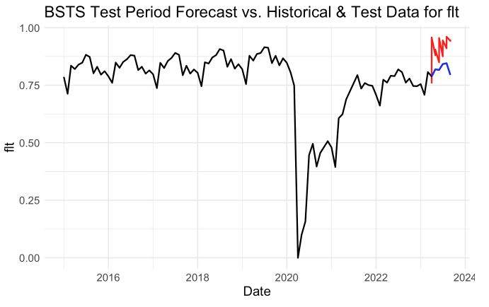
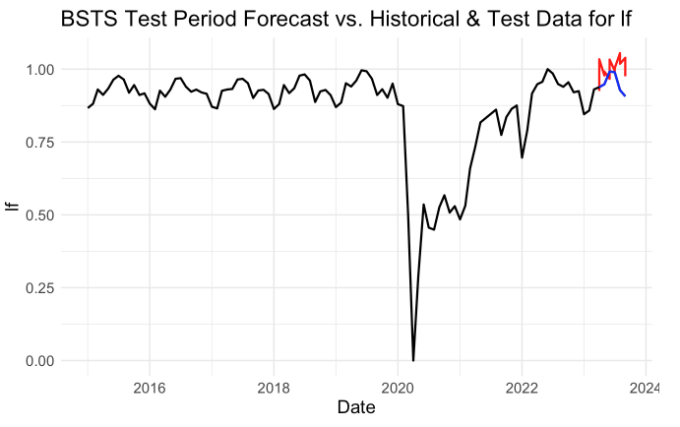
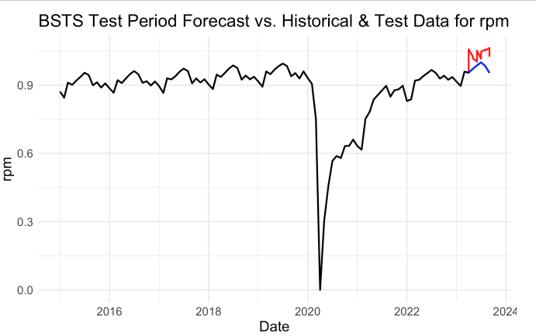
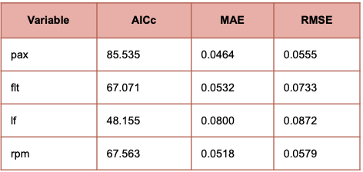
BSTS (Bayesian Structural Time Series)
BSTS effectively captures trend, seasonality, and external factors while handling uncertainty and structural changes. Unlike SARIMA, BSTS flexibly incorporates external regressors without rigid assumptions, potentially improving predictions when economic factors influence travel patterns.
Key Findings:
Although BSTS captures the overall seasonal variation well, it overestimates the test period, producing forecasts higher than actual values, possibly because the model overweights external regressors, assuming they drive stronger growth than observed.
BSTS performs worser than SARIMA, likely because BSTS struggles with short-term fluctuations despite handling external factors. SARIMA focuses on pure time-series dependencies, avoiding potential overfitting to external variables in BSTS.

Slide 13
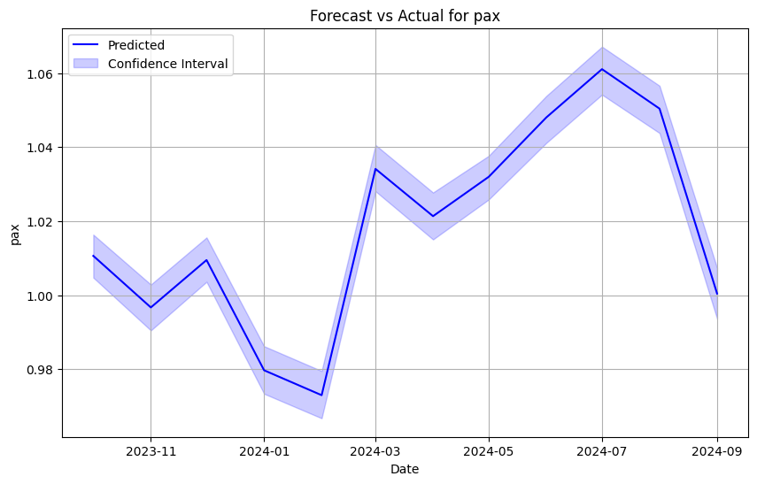
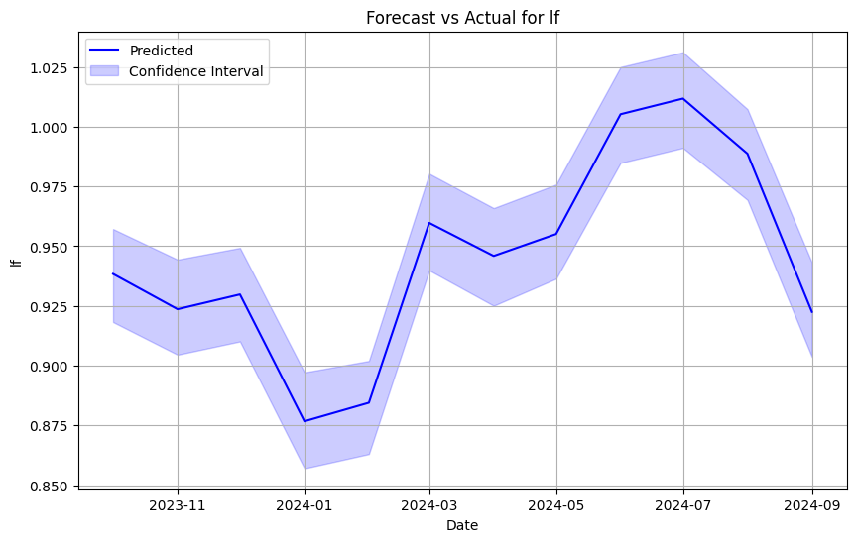
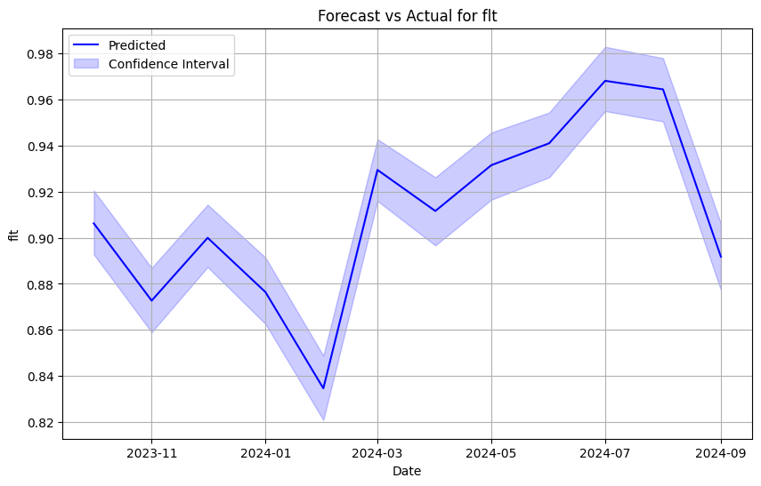
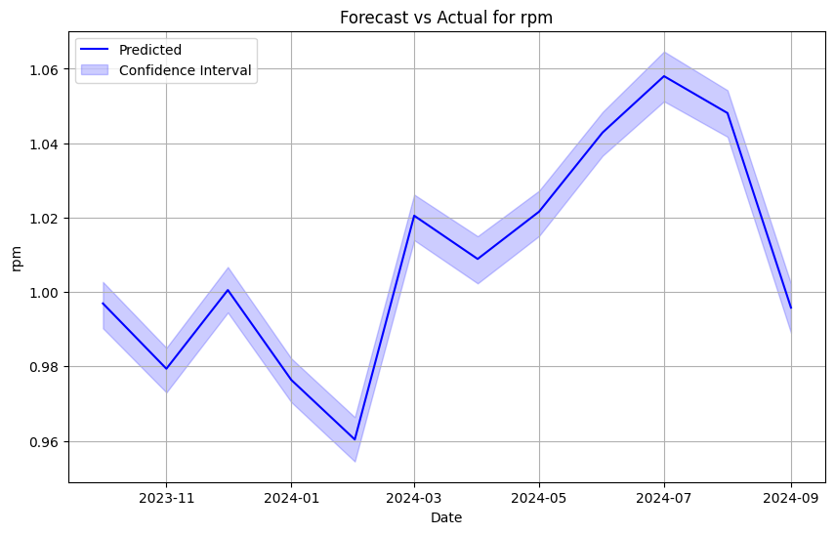
Prophet
Forecast Results & Accuracy
· Pax: RMSE = 0.0755, MAE = 0.0734
· Flt: RMSE = 0.0901, MAE = 0.0891
· LF: RMSE = 0.1090, MAE = 0.1025
· RPM: RMSE = 0.0928, MAE = 0.0907
Key Findings:
The Prophet model performed well across all four target variables. The forecasts for Pax and Flt show low RMSE and MAE, indicating high accuracy. The confidence intervals in the graph represent the uncertainty around these predictions, showing that the model provides a reliable but slightly more uncertain forecast for LF.
Prophet is a forecasting tool designed for time series data with strong seasonal patterns. It handles missing data, outliers, and includes flexibility for incorporating external factors like holidays or GDP. Prophet is widely used for predicting trends in industries like retail and transportation.

Slide 14
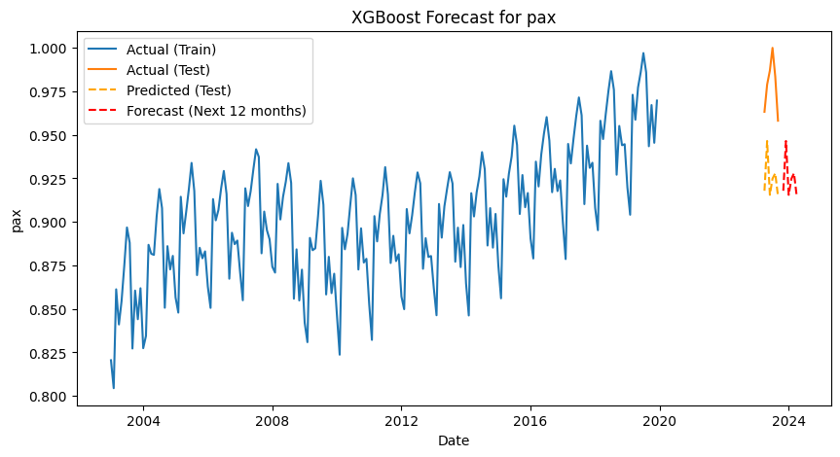
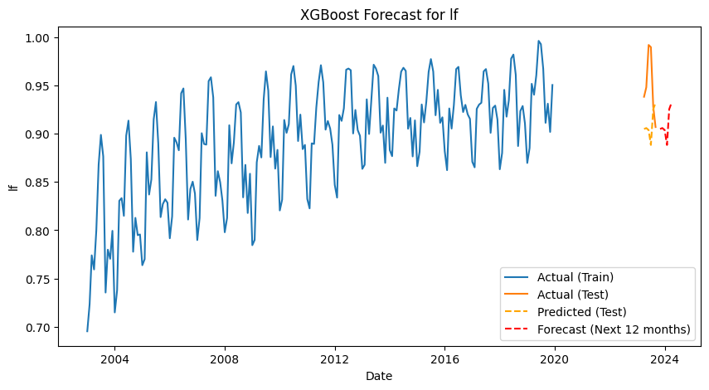
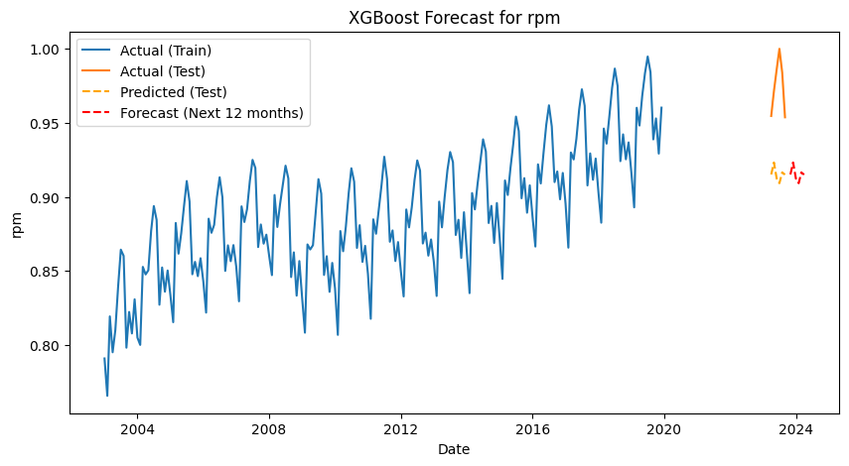
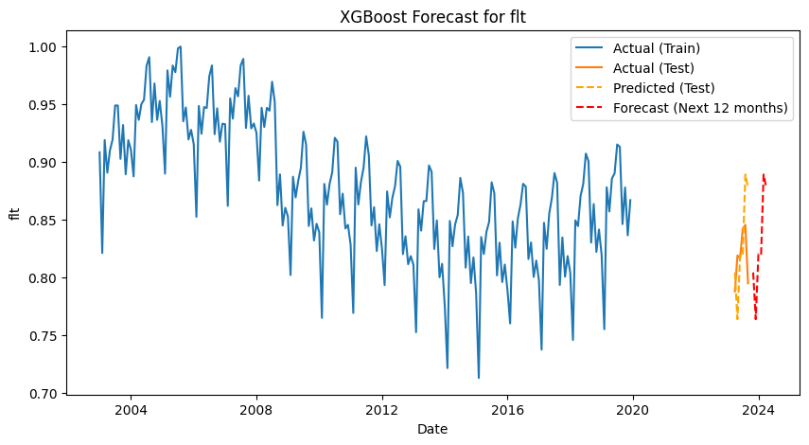
XGBoost
Forecast Results & Accuracy
· Pax: RMSE = 0.0560, MAE = 0.0539
· Flt: RMSE = 0.0459, MAE = 0.0374
· LF: RMSE = 0.0599, MAE = 0.0488
· RPM: RMSE = 0.0627, MAE = 0.0597
Key Findings:
The XGBoost model performed well in forecasting the four key variables. The predictions in the graph show that the model tracks actual data closely. The RMSE and MAE values confirm that the model provides accurate predictions, with Flt showing the best performance.
XGBoost is a highly efficient machine learning algorithm used for regression and classification tasks. It builds an ensemble of decision trees, optimizing prediction accuracy by correcting errors made by previous trees. XGBoost is popular for time series forecasting due to its ability to handle complex patterns and large datasets effectively.

Slide 15
Model Evaluation
Variable | Best Model | RMSE | MAE
pax | SARIMA | 0.033 | 0.027
flt | XGBoost | 0.0405 | 0.0345
lf | SARIMAX | 0.031 | 0.025
rpm | SARIMA | 0.036 | 0.031
SARIMA performed best for pax, lf, and rpm because these variables exhibit strong seasonality and trends, which SARIMA effectively captures through autoregressive and seasonal components. These metrics follow predictable passenger demand cycles, making SARIMA a natural fit.
XGBoost, on the other hand, excelled for flt because flight count is influenced by external factors such as operational changes and weather disruptions, which introduce nonlinear patterns. Unlike SARIMA, XGBoost can detect complex interactions that do not follow strict seasonality.
Prophet and BTST were less effective because Prophet may have over-smoothed trends, while BTST lacked the adaptability of XGBoost. The results highlight SARIMA’s strength in structured seasonal data and XGBoost’s ability to model irregular fluctuations.

Slide 16
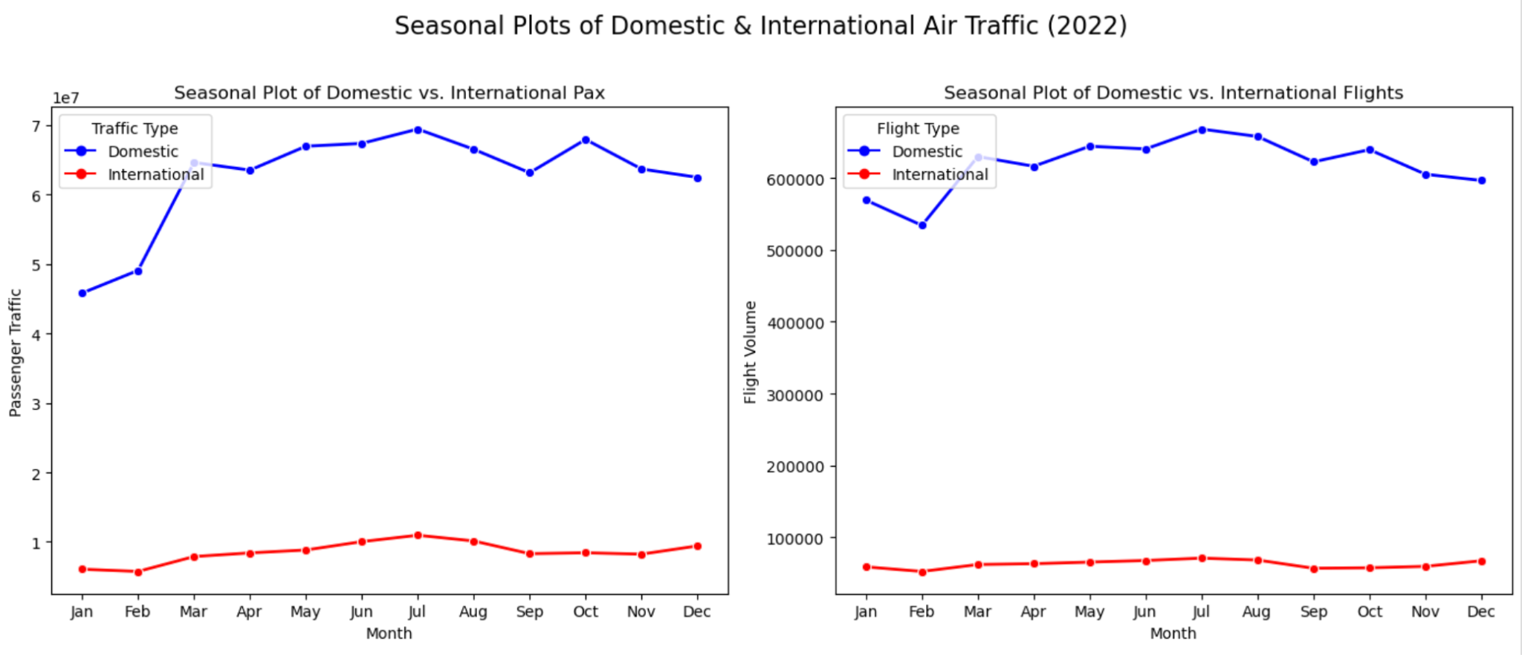
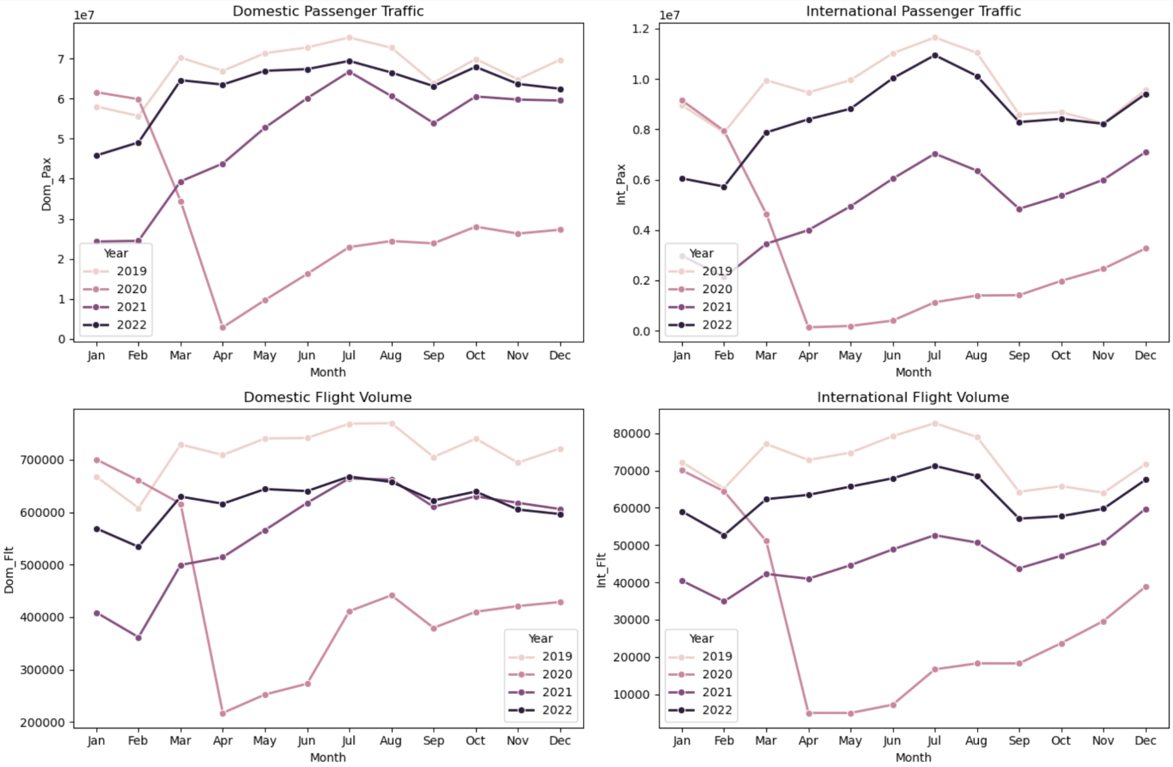
Comparison Between International and Domestic Passengers and Flights
In 2019, both domestic and international travel peaked in summer. 2020 saw a collapse, especially in international travel. Recovery began in 2021, with domestic travel rebounding much faster than international due to fewer restrictions. By 2022, domestic passenger traffic approached pre-pandemic levels, while international travel remained low. Flight volumes also declined and yet to recover as of Sep. 2023, with staffing shortages and operational constraints limiting capacity. International flight volume is still well below 2019 levels.

Slide 17
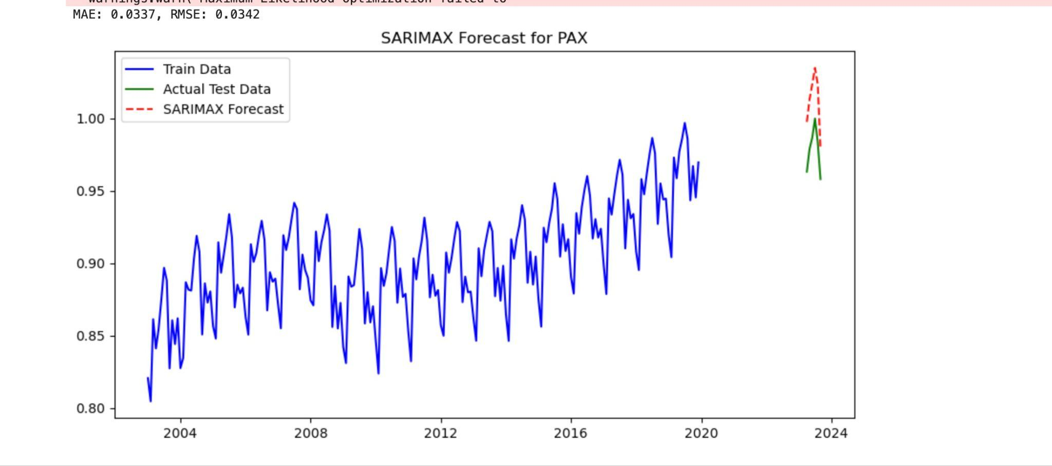
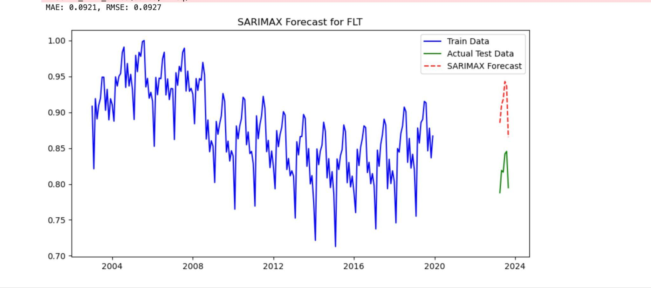
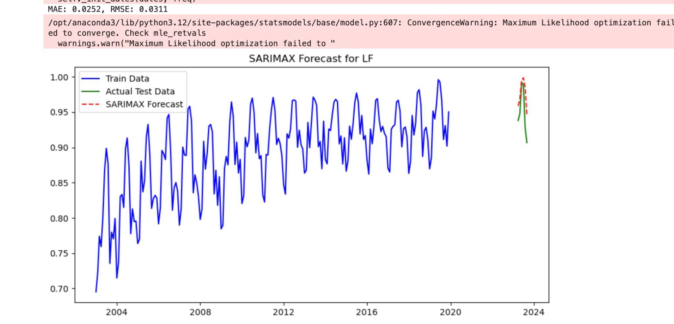
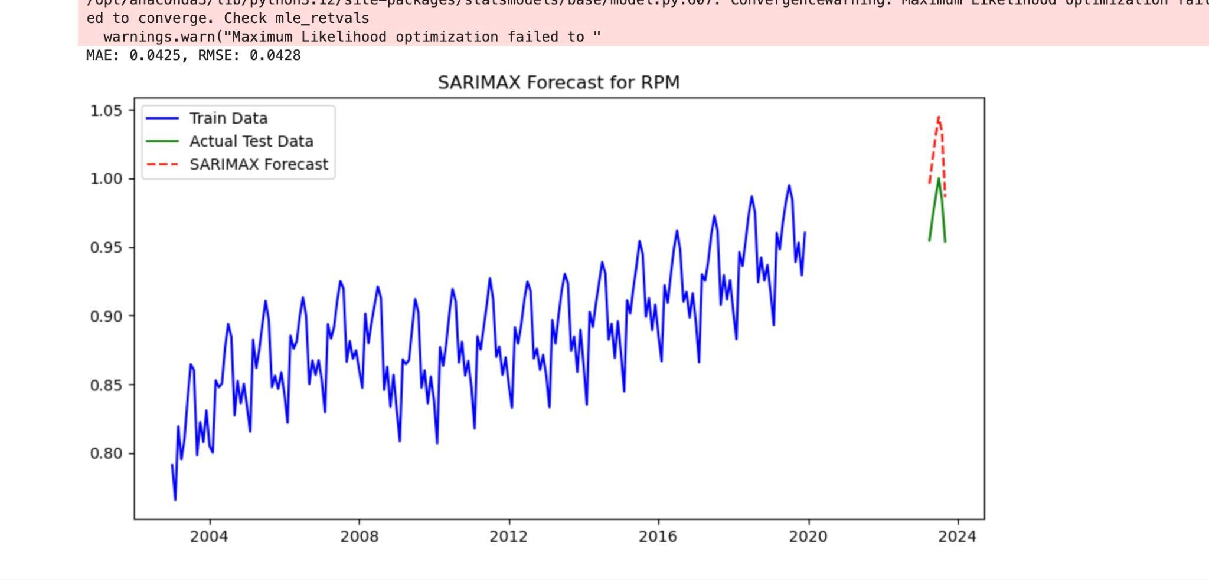
How do long-term trends in U.S. airline travel differ between the pre-COVID and post-COVID periods?
PAX and RPM: higher predicted values than actual, suggesting while passenger demand is recovering, it has not yet reached normal levels.
FLT has a significant gap between predicted and actual values, with predictions much higher than reality, this is likely due to policy restrictions that continue to limit flight availability.
LF closely matches predictions, suggesting that while seat demand is gradually recovering, the number of available flights remains constrained, leading to flights operating at nearly full capacity, similar to pre-COVID levels, despite lower overall flight availability.
The SARIMAX model effectively captures the seasonality of the data, as seen in the recurring spikes. However, it predicts a higher year-over-year trend than actual. This discrepancy is likely due to a lagging recovery from COVID, which has slowed down the expected growth in air traffic metrics.
Notes:
PAX and RPM are both related to passengers, however, the predicted values for both metrics are higher than actual figures, suggesting that while demand is recovering post-COVID, it has yet to fully rebound to expected levels. In contrast, the FLT (flights) metric shows a significant gap between predicted and actual values, with predictions much higher than reality. This discrepancy likely stems from policy restrictions that continue to limit flight availability, preventing the industry from operating at pre-pandemic capacity. Meanwhile, the Load Factor (LF) plot exhibits a near-perfect match between predicted and actual values, implying that while seat demand is gradually recovering, the number of available flights remains constrained. As a result, flights are operating at nearly full capacity, similar to pre-COVID levels, even though overall flight availability has yet to catch up.

Slide 18
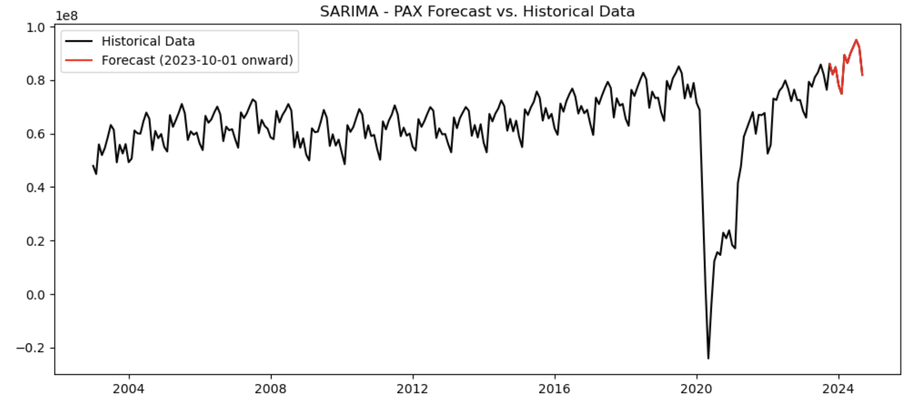
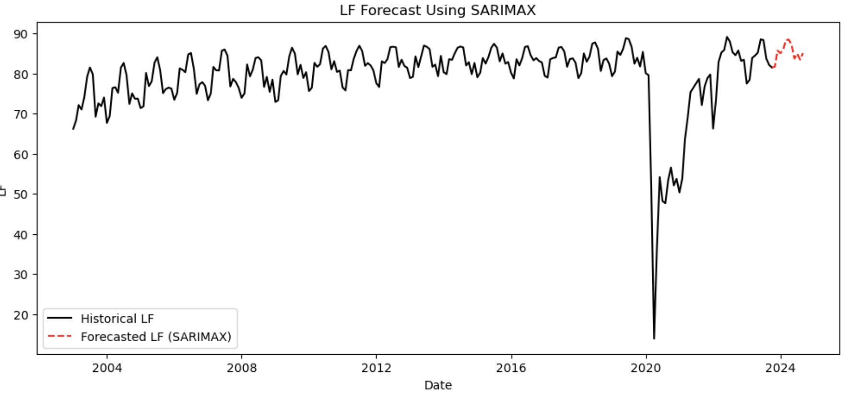
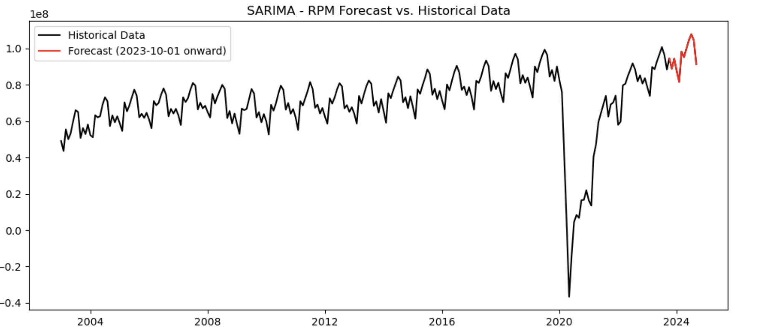
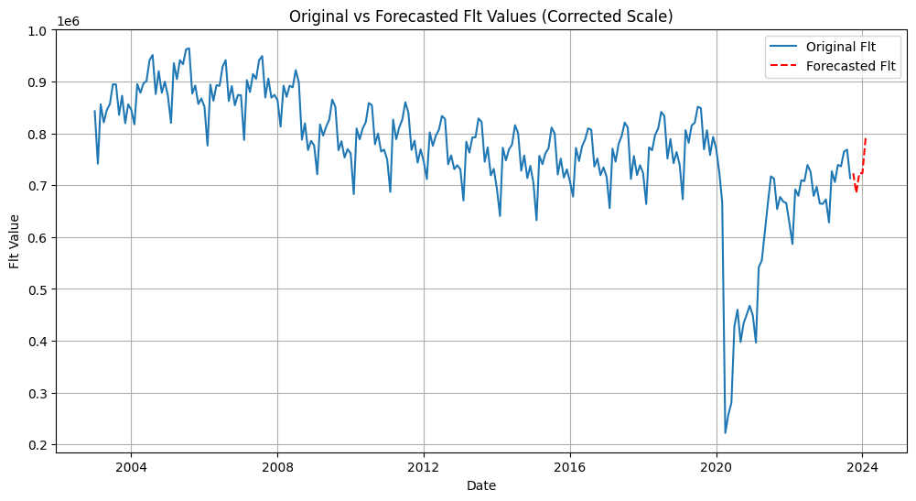
Forecast
Our prediction (in red) is aligned with the overall trend and seasonal fluctuation. With our predicted number of passengers and flight volume, airlines can strategically plan fleet allocation, optimize scheduling, and adjust staffing levels to meet anticipated demand efficiently while maintaining profitability.

Slide 19
Business Implications
PAX and RPM reflect passenger demand. While number of passengers are recovering, number of flight is recovering at a slower pace, and load factor remains high, indicating that demand exceeds supply.
Pilot/Captain shortages may be limiting flight capacity.
Policy restrictions may be affecting operations, requiring continuous monitoring of regulations.
Add new flight route, or adjust aircraft deployment by using larger planes on high-demand routes and smaller regional jets on low-demand routes.
Seasonal demand accommodation: we can increase our flights during peak seasons like summer vacation (June to August) or holiday seasons
Operational Bottlenecks due to workforce shortages: In addition to pilot shortages, air traffic control (ATC) and ground operations staffing shortages can create delays and limit the number of flights airlines can operate. To address this, airlines should collaborate with aviation authorities to push for increased ATC staffing, enhance ground crew efficiency through automation and AI-assisted scheduling, and optimize flight scheduling to reduce congestion at peak hours.

Slide 20
Appendix

Slide 21
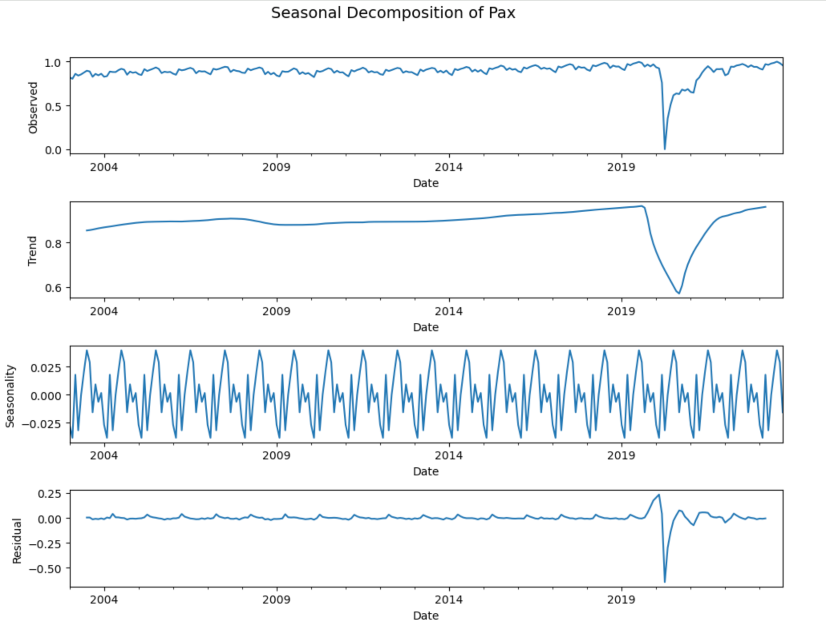
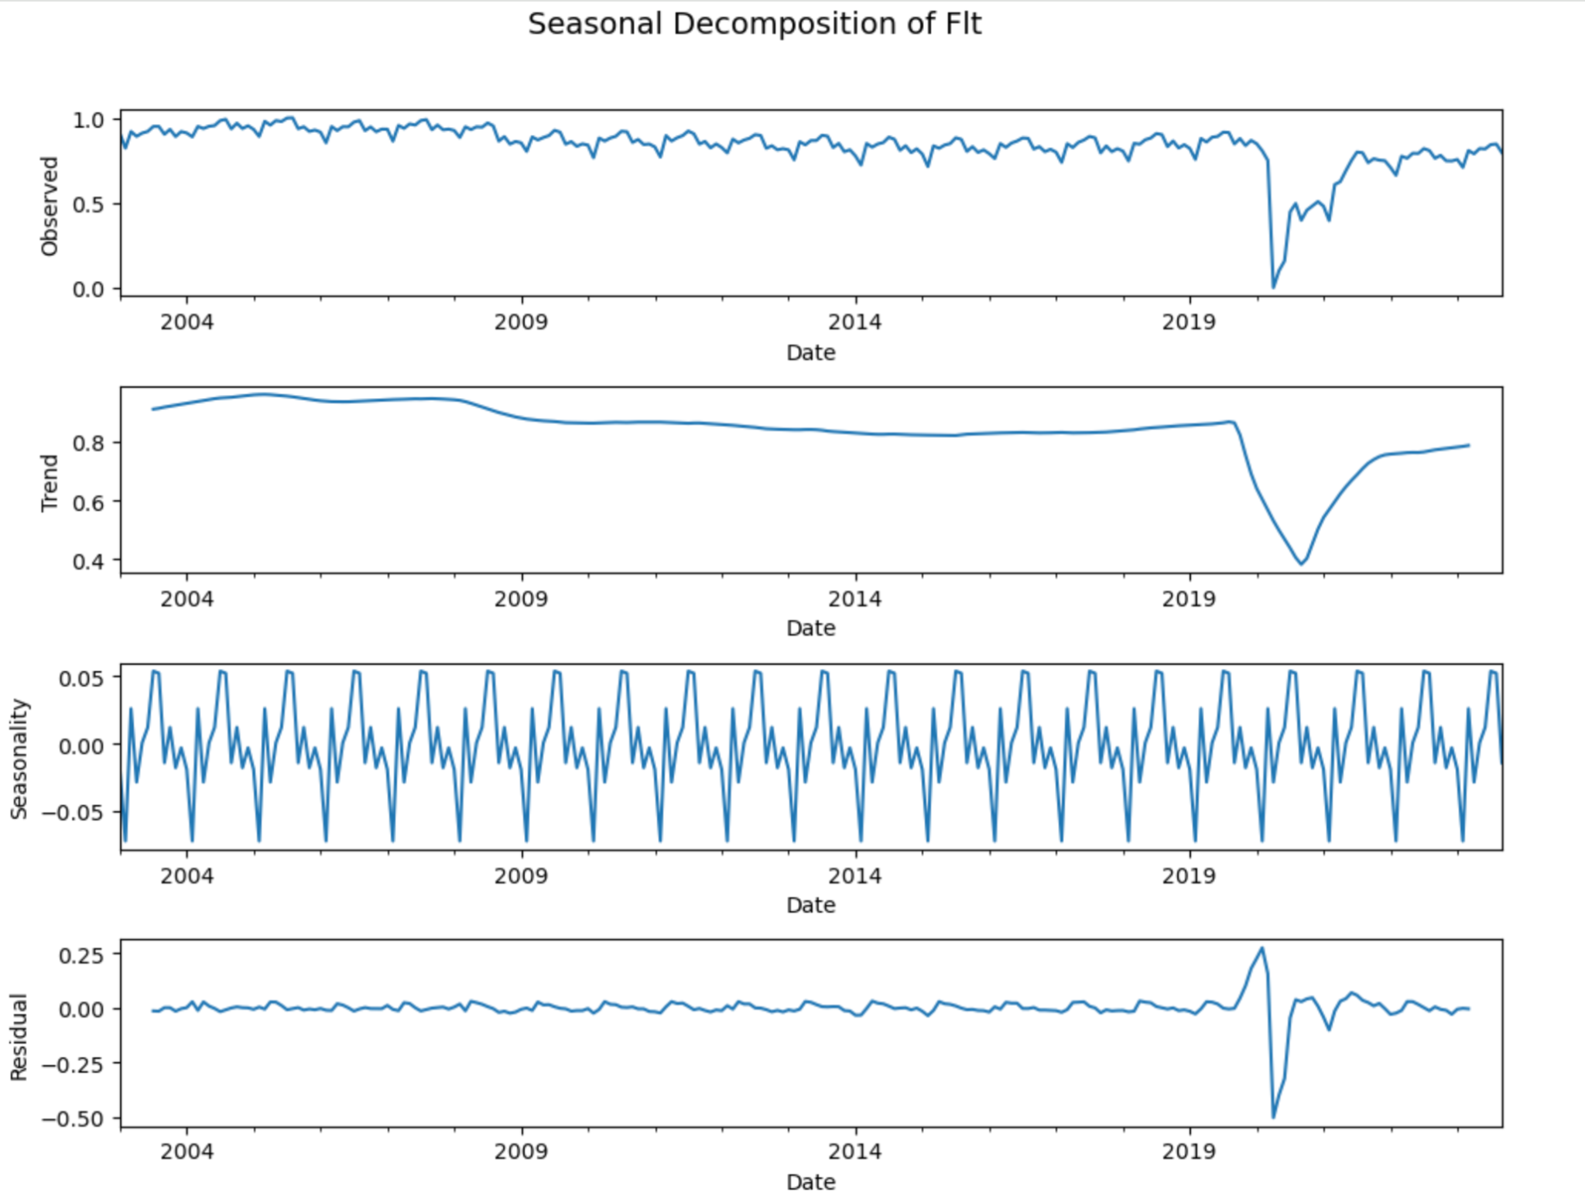
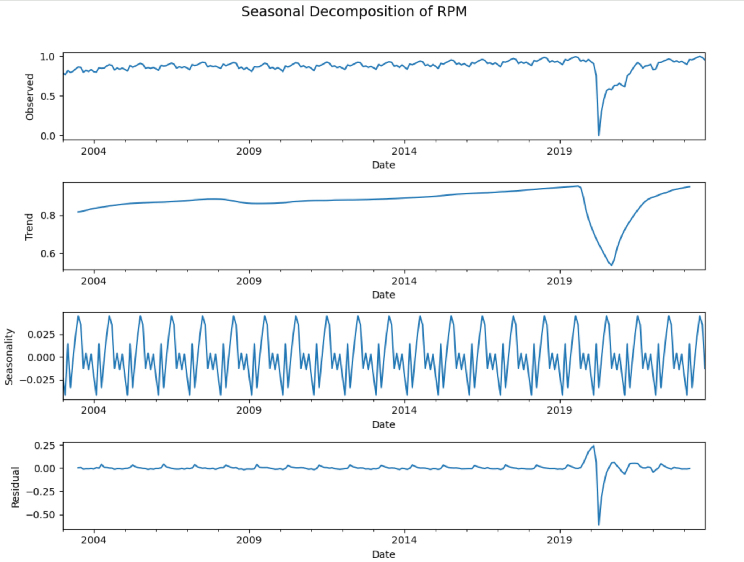
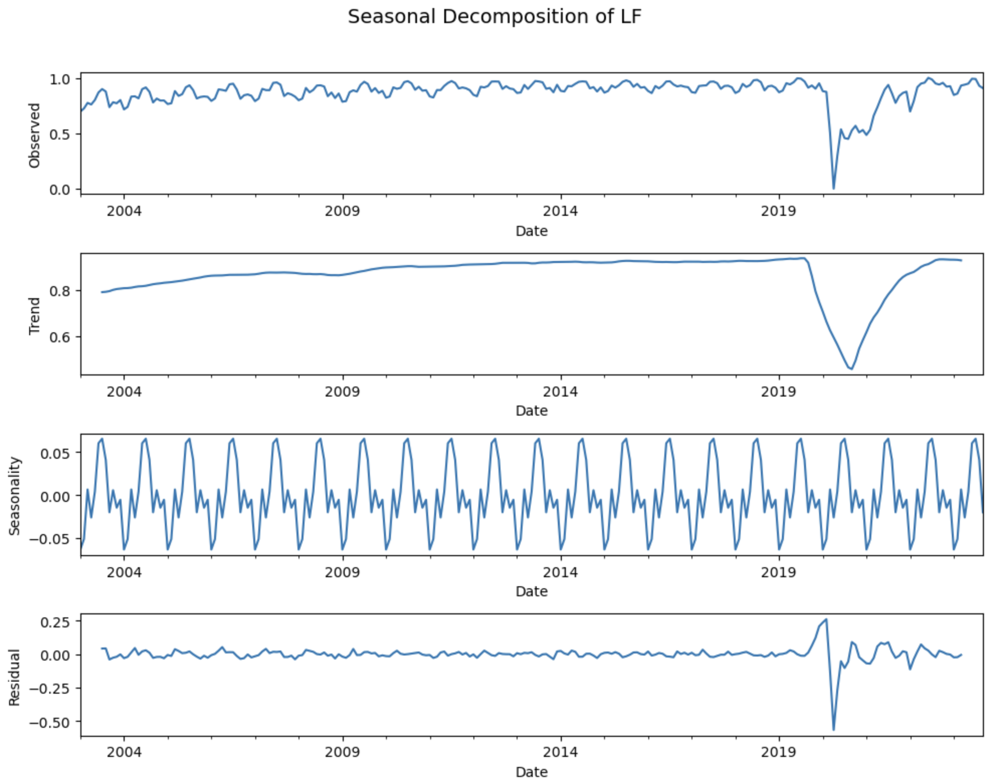
Notes:
Seasonal Decompositions Proved Seasonality

Slide 22
Appendix: Reasons for Choosing Evaluation Metrics
RMSE and MAE
RMSE measures prediction accuracy, penalizing large errors more due to squaring.
MAE provides an interpretable average error, focusing on absolute deviations.
RMSE captures large deviations, while MAE ensures interpretability of forecast accuracy. Together, they can offer us a good indication to performance across models.
Prophet,
XGBoost
AICc
Due to our small sample size (204 in use), AICc adjusts for small-sample effects, providing a better model selection criterion than AIC, which can’t handle small-sample bias well.
SARIMA,
BSTS
rely on likelihood-based metrics

Slide 23
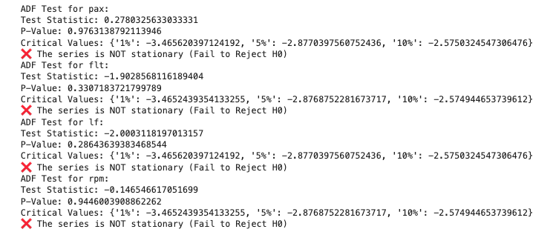
Appendix: ADF Results

Slide 24
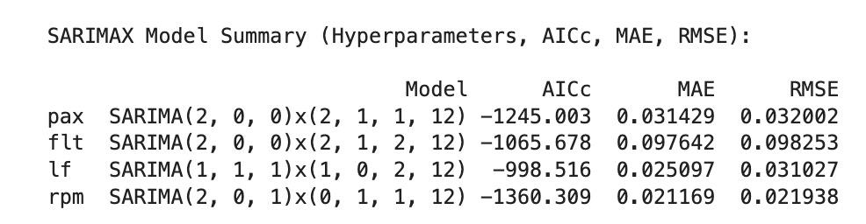
Appendix: SARIMAX Model Results
SARIMAX aligns better with seasonal variation but performs worse overall, with forecasts deviating farther from actual test data.
Inclusion of external factors may introduce noise or overfitting, leading to less reliable predictions.
SARIMAX struggles to balance external influences, possibly because economic indicators (e.g., price, GDP) have delayed or indirect effects on short-term patterns.
SARIMA, despite being simpler, outperforms SARIMAX as it focuses on purely time-dependent relationships, avoiding the uncertainty introduced by external regressors.

Slide 25
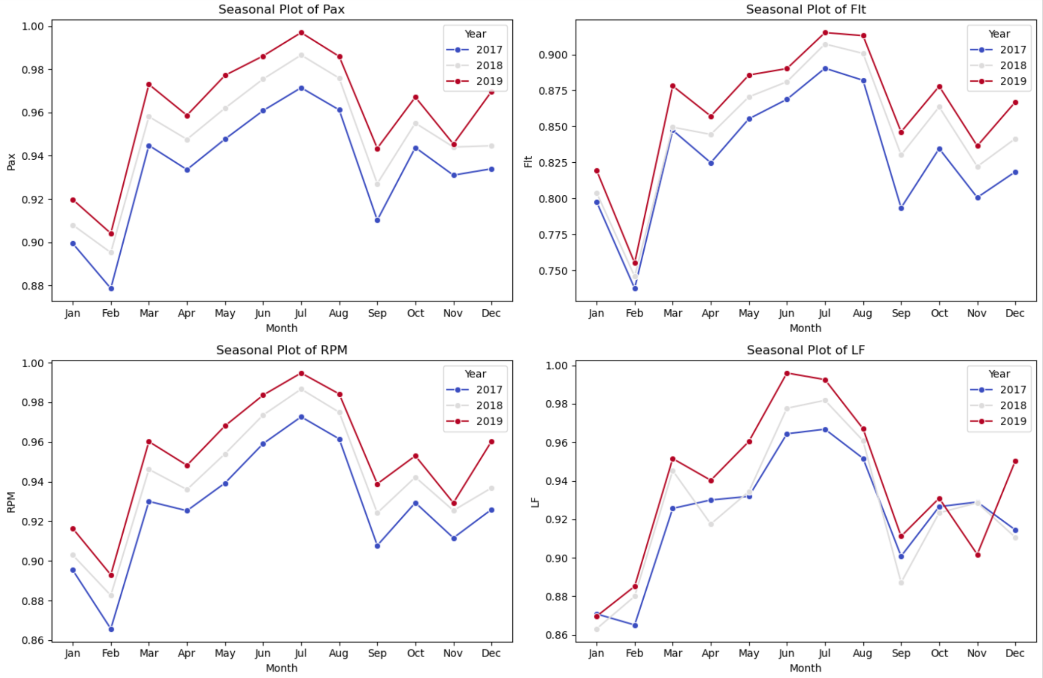
Appendix: Seasonal plot 2017 - 2019
Our target variables in the air traffic dataset is seeing a consistent seasonal pattern and an increasing trend over the years. Post COVID data shows a similar pattern and trend.

Slide 26
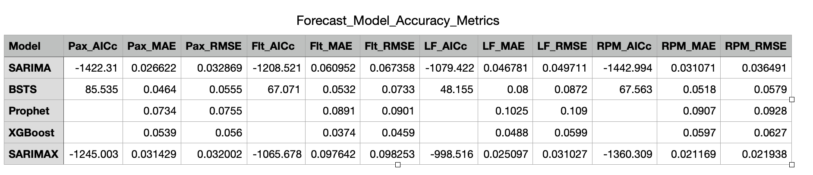
Appendix: Model Comparison

Slide 27
Data Source
Air Traffic dataset: https://www.kaggle.com/datasets/yyxian/u-s-airline-traffic-data
Jet Fuel Price: https://www.eia.gov/dnav/pet/hist/LeafHandler.ashx?n=PET&s=EER_EPJK_PF4_RGC_DPG&f=M
Monthly GDP dataset: https://www.spglobal.com/market-intelligence/en/solutions/products/us-monthly-gdp-index

